Slide 2
Presented Problem
Big Mountain Resort (BMR) wants to know if their current price point of $81 is too low for their current offerings
Can a higher price point be supported based on analyzing competitors?
BMR also wants to know if they should take various actions to improve profitability:
Closing up to 10 potential runs
Installing an additional chair lift (which costs $1,540,000) to expand capabilities
Increasing the length of its longest run

Slide 3
Executive Summary
Big Mountain Resort (BMR) could increase its price to $95.87 (from $81) based on Weekend Adult prices and its offerings
This price is supported by a Random Forest prediction model based on the competitors provided to us by BMR
We also recommend two possible operating changes for BMR:
Installing an additional chair lift (which costs $1,540,000) to expand capabilities
Expected to both further increase price by $1.12 (totaling $96.99) and further increase operating revenues
Close down the least frequently used run as this is expected to have no significant impact on price.

Slide 4
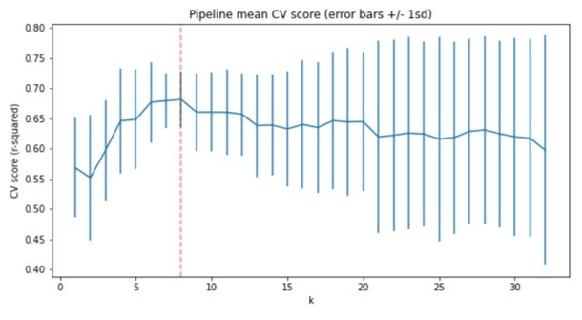
Model Overview
We selected a Random Forest model to best predict price on 8 key characteristics of a snow resort:
Vertical Drop
Snowmaking Coverage
Total Chairs
Fast Quads
Runs
Longest Run
Trams
Skiable Terrain
These 8 characteristics gave us a good balance of price prediction accuracy on our training set while not becoming overly specialized and losing predictive power on our testing set
This gives us greater confidence in recommending the price of $95.87 for BMR if it were to do nothing else but increase price

Slide 5
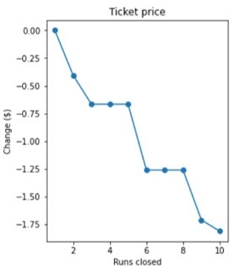
Scenario Analysis
In relation to the 4 possible scenarios presented by management, we split them into 2 key groups
Group A: Scenarios strictly involving cost-cutting (e.g., closing down infrequently used runs)
Group B: Scenarios involving an increase in capabilities (e.g., installing the new chair lift, increasing the vertical drop, increasing snowmaking capabilities, etc.)
Group A results shown to the right
The model predicts that closing the least frequently used run would put no downward pressure on price. However, once you were to close 2 or more runs, there would be downward pressure on price.
The model also predicts that closing 5 runs would have effectively the same downward pressure on price as closing 3 runs

Slide 6
Investment Scenarios Analysis (Group B)
 | Expected Price Increase | Expected Revenue Increase | Expected Cost Increase | Expected Net Operating Revenue
Scenario 2 | $1.12 | $1,952,899 | $1,540,000 | $412,899
Scenario 3 | $1.99 | $3,474,638 | $1,540,000 + Snowcost | ?
Scenario 4 | $0.00 | $0.00 | ? | ?
We present the following table regarding the different scenarios presented by management
Scenario 2: Additional chair lift, increased vertical drop, and an additional run
Scenario 3: Additional chair lift, increased vertical drop, an additional run, and 2 more acres of snowmaking
Scenario 4: Longest run’s length increased by 0.2 miles and 4 more acres of snowmaking
We recommend Scenario 2 as it provides an expected increase in operating revenues based on modeled price increases and known expected cost increases
Scenario 3 provides the possibility of a price increase above Scenario 2 but requires for the cost of increasing snowmaking capabilities to remain low. Due to a lack of data regarding this additional cost, we’d recommend not implementing the change unless more concrete data came to light
We do not recommend Scenario 4 as it was not expected to increase the price any further and would require spending resources

Slide 7
Conclusions
BMR could increase its price to $95.87 and change nothing else
Based on model predictions built on competitors data
BMR could close its least frequently used run and experience no downward pressure on price
If BMR wanted to close more than 1 run, it would need to evaluate the downward pressure on price versus the expected decrease in operating costs
BMR could proceed to install the additional chair lift (with the additional run) and be confident it will increase operating revenues
More data would be necessary to evaluate whether increasing snowmaking capabilities would be a profitable endeavor

Slide 8
Thank You!
Contact Info:
Presenter: Emre Guzelsu
Email: emre.guzelsu@gmail.com

